Slide 1
Rossman Project
Team Awesome Incredible:
Avinash Kamath, Kyle bartsch, prateek bhadsavle

Slide 2
Data Cleansing

Slide 3
Data Types
Many variables need to be converted to correct data types:
Integers -> Factors
Factors -> Dates
Factors -> Integers
Critical piece to get correct – drives appropriate variable behavior in modeling

Slide 4
Missing Values
Stores Dataset:
Competition Distance – only for 3 stores (#81,#862,#957 )
Competition Open Since Month / Competition Open Since Year – 317 stores
Affects Competition Open Date – if values are NA, we cannot derive some features like “time since competition opened”
Promo2 Since Week / Promo2 Since Year – 486 Stores
Affects Promo2 – Appears if Promo2 = 0, it never was offered and the date values are truly unknown.

Slide 5
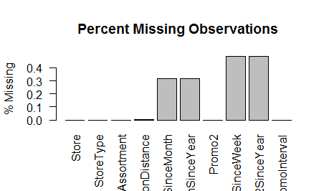

Slide 6
Imputing Missing Values
Competition Distance – May not be worth the time (3 stores)
No single other attribute appears to be predictive of Competition Distance
Perhaps we can use K-means clustering to find similar stores?
Then impute based on an average of Competition Distance of similar stores?
Or use dummy variable to indicate “missingness”
Competition Open Date – Highly missing, but may be predictive
No other attributes seem to be predictive of Open Date
Perhaps we can use K-means clustering to find similar stores?
Promo2 Start Date – No need
When Promo2 = 0, the promo was not offered

Slide 7
Feature Engineering

Slide 8
Features We Engineered:
Calendar Dataframe
Using the Calendar Data frame, we extracted following features for each sale date:
Competition Open Date
Weeks Since Comp Opened
Promo 2 Start Date
Promo 2 Valid (Binary)

Slide 9
Calendar Data frame:
To extract exact dates for CompetitionOpenSince and Promo2 we created a Calendar Data frame with following data:
Date
Dayofyear
Dayofweek
Weekday
Dayofmonth
Weeknumber
Month
Quarter
Year

Slide 10
Competition Open Date & Weeks since:
From the calendar data frame the following were extracted:
CompetitionOpenDate = CompetitionOpenSinceMonth + CompetitionOpenSinceYear (1st day of month in that year)
WeeksSinceCompOpened = Sale Date – Competition Open Date

Slide 11
Promo 2 start date and validity for a sale date:
From the calendar data frame the following were extracted:
Promo2StartDate = Promo2SinceWeek + Promo2SinceYear (Monday of that week of that year)
Promo2 Valid = 1 , If:
Sale Date > Promo2StartDate
&
If the sale month = one of the promointerval month

Slide 12
Exploratory Data Analysis

Slide 13
Univariate EDA

Slide 14
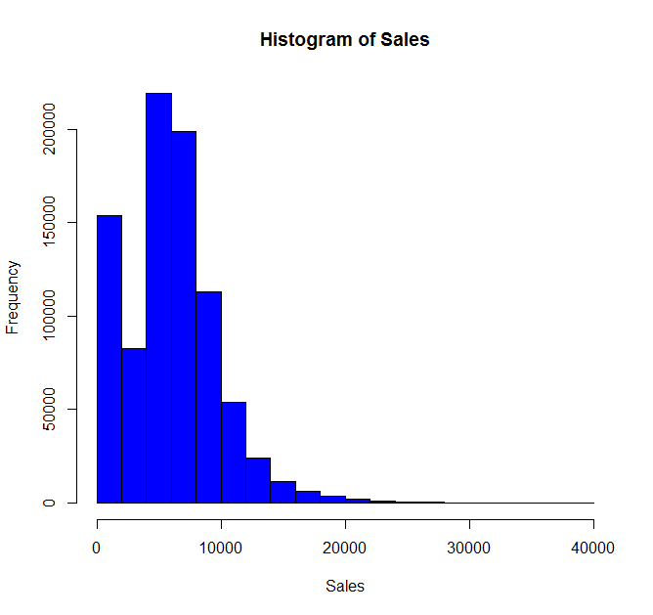

Slide 15
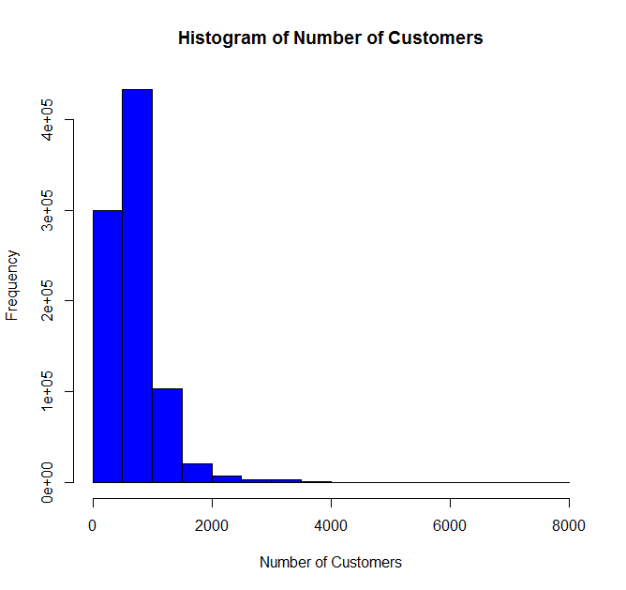

Slide 16
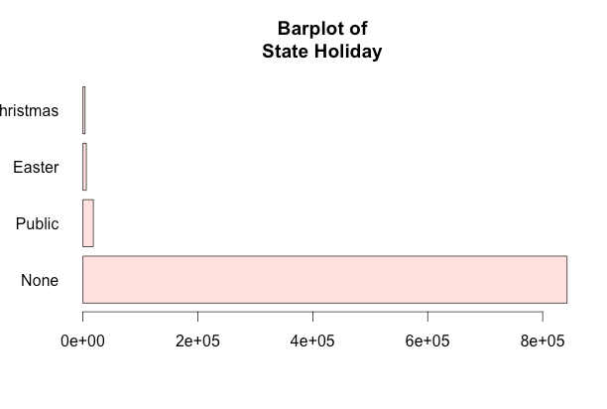

Slide 17
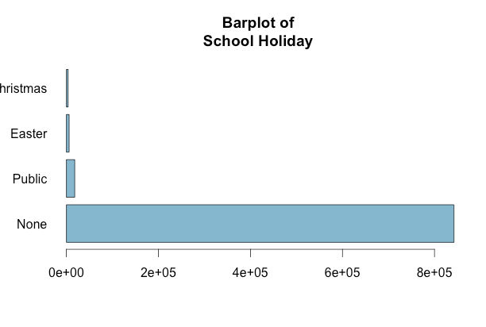

Slide 18
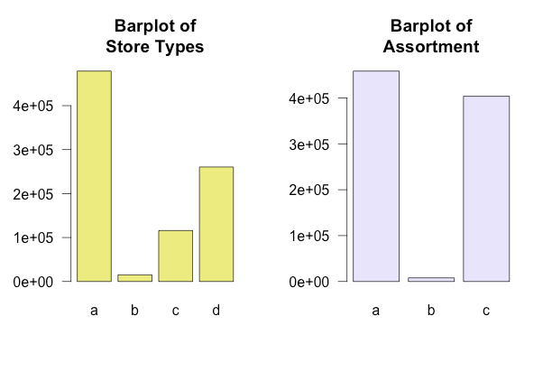

Slide 19
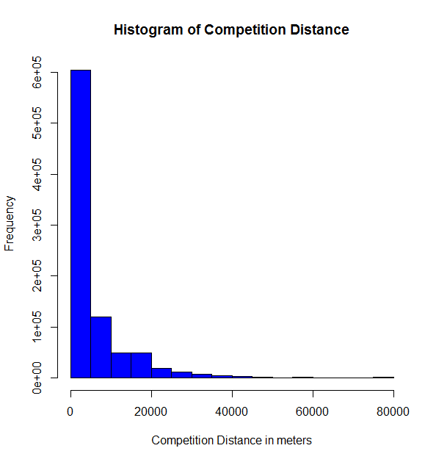

Slide 20
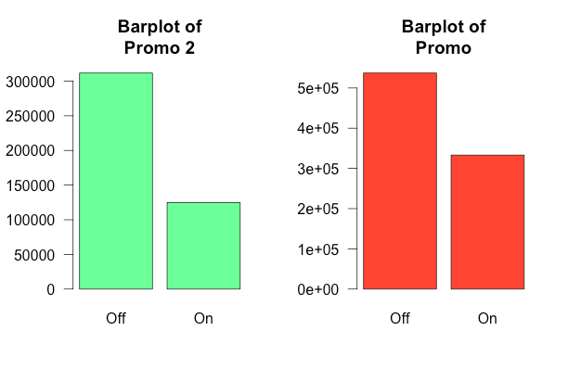

Slide 21
Bivariate EDA

Slide 22
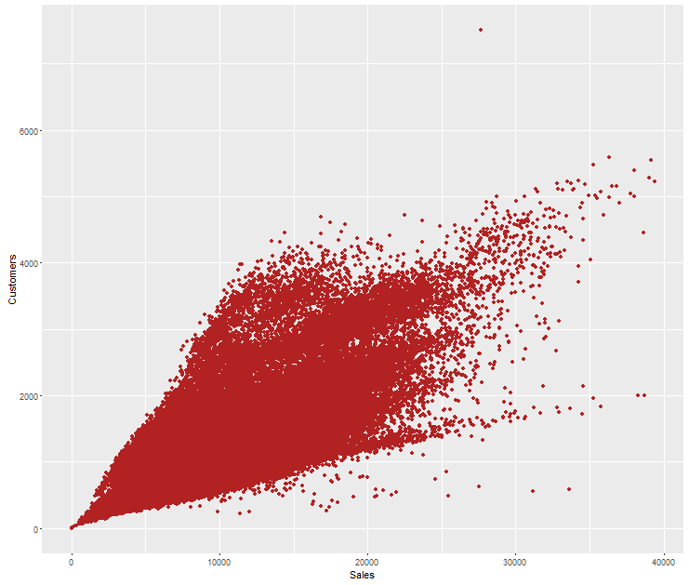
Customer vs Sales

Slide 23
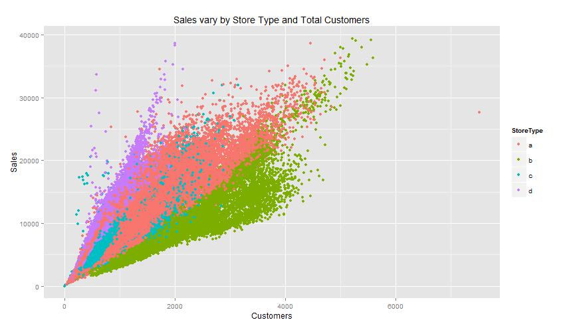
Sales vs. Total Customers/Store Type

Slide 24
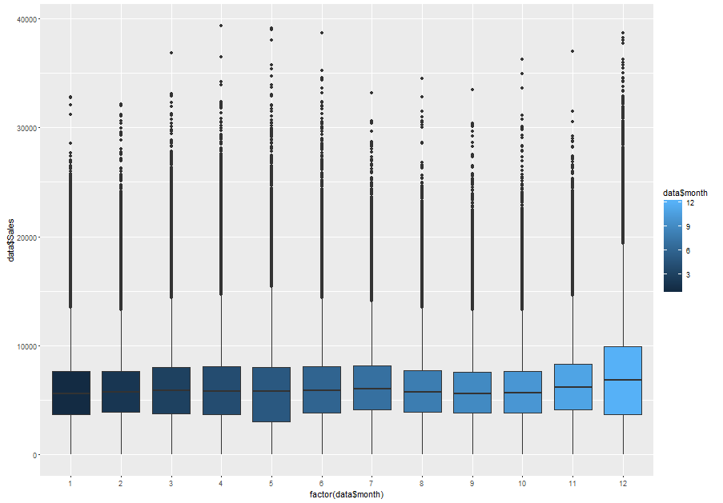
Sales vs Month

Slide 25
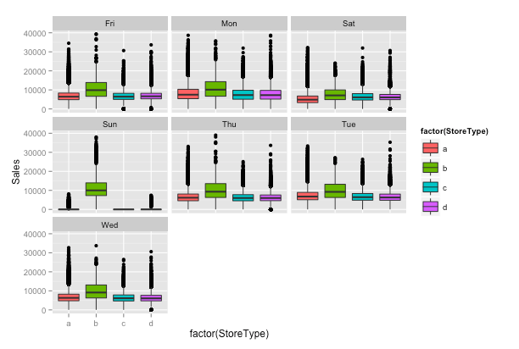
Sales – weekday- store type

Slide 26
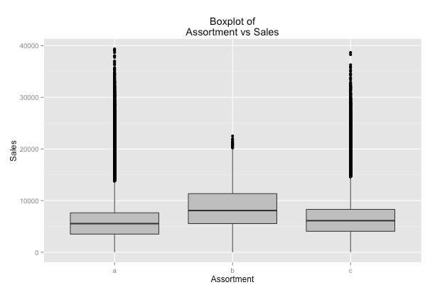
Sales vs Assortment

Slide 27
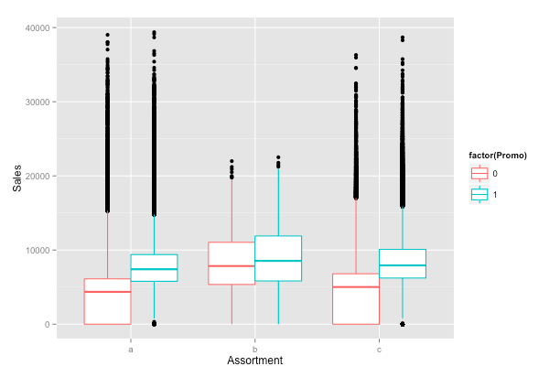
Sales vs Assortment by Promo

Slide 28
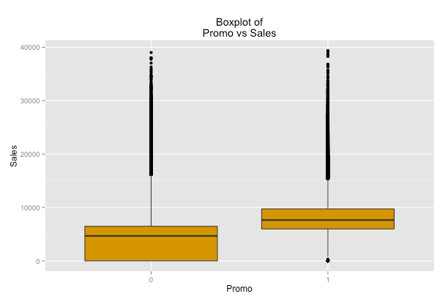
Promo vs Sales

Slide 29
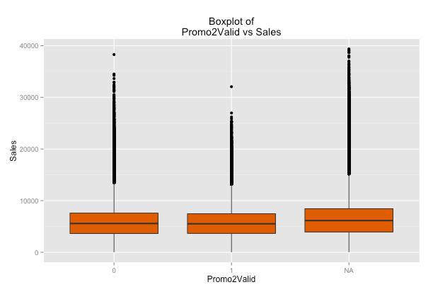
Promo2Valid vs Sales

Slide 30
Most Valuable Features as per EDA
Total Customers
Store Type
Assortment
Promo

Slide 31
Plans for data modeling

Slide 32
Modeling Techniques To Consider:
Traditional Linear Regression
Start with stepwise selection for dimension reduction
Determine optimal # of dimensions based on AIC
Add higher order terms?
Regression Trees
Start will all dimensions
Prune tree to find most parsimonious model
Bagging (Bootstrap Aggregating)
Use all dimensions – be wary of overfitting

Slide 33
Modeling Techniques To Consider:
Random Forest
# of dimensions (usually square root of # of dimensions)
# of trees to build
Boosting
Parameter Tuning:
# of trees to build
Interaction depth
Shrinkage – how fast will the model “learn”

Slide 34
General Modeling Parameters
Use Cross Validation (5-Fold) to assess model performance
We will NOT Use R2!
With a high n, we risk overfitting by adding variables
Use Caret Package to optimize model parameters

